Slide 1
Financial Sector (Egypt)
Maged Ibrahim Eid
2021

Slide 2

Overview
The financial sector is made up of many different industries ranging from banks, investment houses, insurance companies, real estate brokers, consumer finance companies, mortgage lenders, and real estate investment trusts (REITs).
In Egypt:
There is 28 commercial banks, 32 business and investment banks and 21 specialized banks.

Slide 3
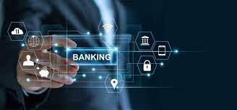
How is data science used in financial services?
Data Science has become very important in the Finance Industry, which is mostly used for Better Risk Management and Risk Analysis. Better analysis leads to better decisions which lead to an increase in profit for financial institutions. Companies also analyze the trends in data through business intelligence tools.

Slide 4
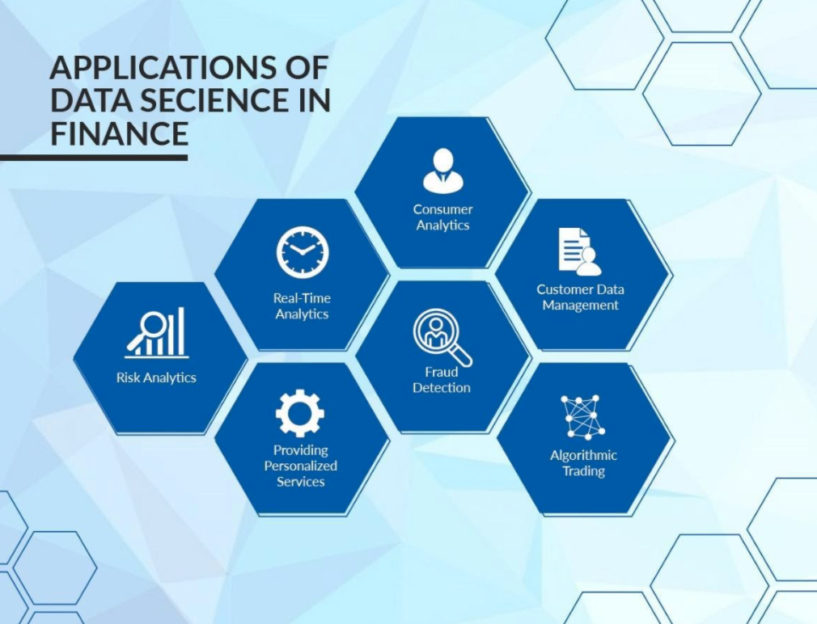
Applications of data science / analytics in finance:
Customer Data Management.
Fraud prevention.
Deep personalization and customization.
Risk management.
Predictive Analytics.
Consumer Analytics.
Algorithmic trading.
Real-Time Analytics.

Slide 5

In depth:
Deep personalization and customization:
Firms realize that one of the key steps to being competitive in today’s market is to raise engagement through high-quality, personalized relationships with their customers. The idea is to analyze digital client experience and modify it taking into account client’s interests and preferences. AI is making significant improvements in understanding human language and emotion, which brings customer personalization to a whole new level. Data engineers can also build models that study the consumers’ behavior and discover situations where customers needed financial advice. The combination of predictive analytic tools and advanced digital delivery options can help with this complicated task, guiding the customer to the best financial solution at the most opportune time and suggesting personalize offerings based on spending habits, social-demographic trends, location, and other preferences.

Slide 6

Consumer analytics:
Real-time analytics also help with better understanding of customers and effective personalization. Sophisticated machine learning algorithms and customer sentiment analysis techniques can generate insights from clients behavior, social media interaction, their feedbacks and opinions and improve personalization and enhance the profit. Since the amount of data is enormously huge, only experienced data scientists can make precise breakdown.

Slide 7

Banks in Egypt:
As in many emerging markets, banks in Egypt are the dominant ﬁnancial institutions. They control most of the ﬁnancial flows and possess most of the ﬁnancial assets in Egypt.

Slide 8
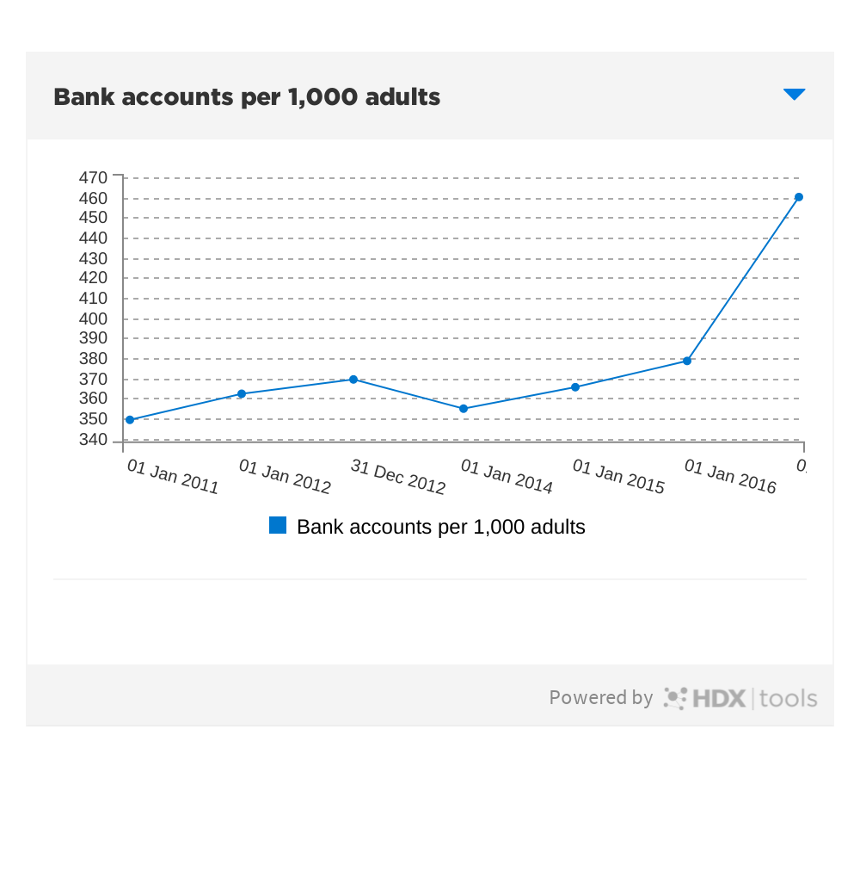
Increasing in banks accounts:
Increase in bank accounts from 2011 to 2016.

Slide 9
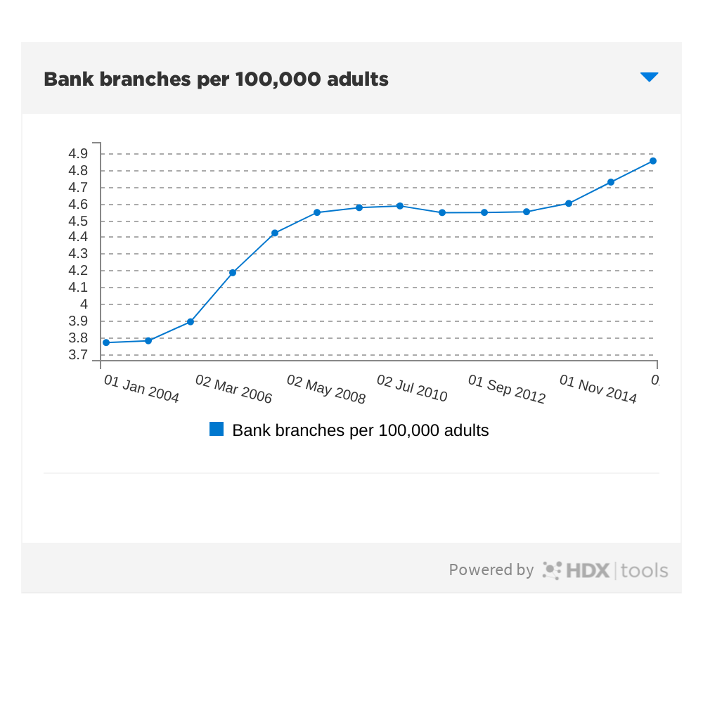
Increasing in banks branches:
Increase in bank branches because of the new customers.

Slide 10
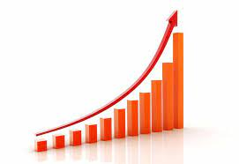
Huge Importunities:
The Central Bank of Egypt (CBE) revealed that the total financial position of banks operating in the local market, other than CBE, increased to about EGP 7.948 trillion in June 2021, compared to EGP 7.554 trillion in March 2021, an increase of EGP 394 billion.

Slide 11

Huge Importunities:
Nearly two thirds of Egypt's population of 102 million are without access to banking services. Slashing this number is a key prerequisite to integrate the country’s vast grey economy - whose financial activity is not taxed or monitored by the government - into the formal sector.

Slide 12

Huge Importunities in Digital Banking:
As of September 2020, Egypt ratified a new banking law that will allow, for the first time, the launch of digital banks.
Laws are still being prepared and should come into effect later this year. Thereafter, the Central Bank of Egypt (CBE) will start granting digital banking licenses, for which several traditional banks have already applied, according to media reports.

Slide 13

Conclusion:
There is a huge importunities in the financial sector In Egypt. There is a tremendous amount of data in Egypt that’s not being used at all. This data could generate insights and ideas worth not only millions of Egyptian pounds but literally without exaggerating hundreds of millions of Egyptian pounds and even more if we involved DS in the financial sector. I see huge potential and opportunities in my country. And I hope to be among the first who put a leg on that treasure island of unused data.

Slide 14

References:
https://oxfordbusinessgroup.com/egypt-2020
https://www.emerald.com/insight/content/doi/10.1108/JHASS-08-2019-0027/full/html#sec003
https://www.kdnuggets.com/2018/05/top-7-data-science-use-cases-finance.html
https://www.netguru.com/blog/data-science-in-finance
https://data.humdata.org/dataset/world-bank-financial-sector-indicators-for-egypt-arab-rep/resource/dffc40b2-44fb-4d48-b7f7-69c0e9e645be
https://www.kaggle.com/saurabhshahane/egyptian-stock-exchange
https://www.theafricareport.com/120901/egypts-fintech-faces-obstacles-to-bring-digital-banking-to-fruition/

Slide 15
Thanks!
Maged Ibrahim

